Slide 1
Visual Studio…What’s New in 2017
Brian Sherwin
Sr. Technical Evangelist
@bsherwin

Slide 2
Getting very close to release
This is RC3
March 7 – Launch
March 7 – 8 VS2017 Event
VisualStudio.com

Slide 3
Let’s get started…

Slide 4
Redefined fundamentals
Faster startup
Faster solution load
Faster builds
Less memory

Slide 5
New Installation Experience
Reduce the minimum footprint of Visual Studio.
Install more quickly with less system impact, and uninstall cleanly.
Make it easier for you to select and install just the features you need.

Slide 6
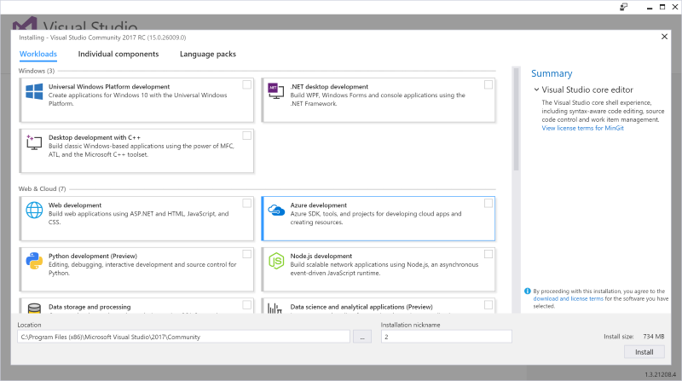

Slide 7
Overall Improvements
GitHub extension for VS can be selected in the installer.
Optimized to reduce startup time and solution load time.
The very first launch is at least 50% faster.
Visual Studio will now monitor extension performance that impacts startup, solution load, or editing.
Reload All Projects has been replaced with Reload Solution.

Slide 8
Overall Improvements
Offline Help – Install the Help Viewer component in the Visual Studio installer.
Version Control status bar
Publish local repos to an SCC host
Keep track of uncommitted and un-pushed work.
The Account Settings dialog is now more accessible to screen readers.

Slide 9
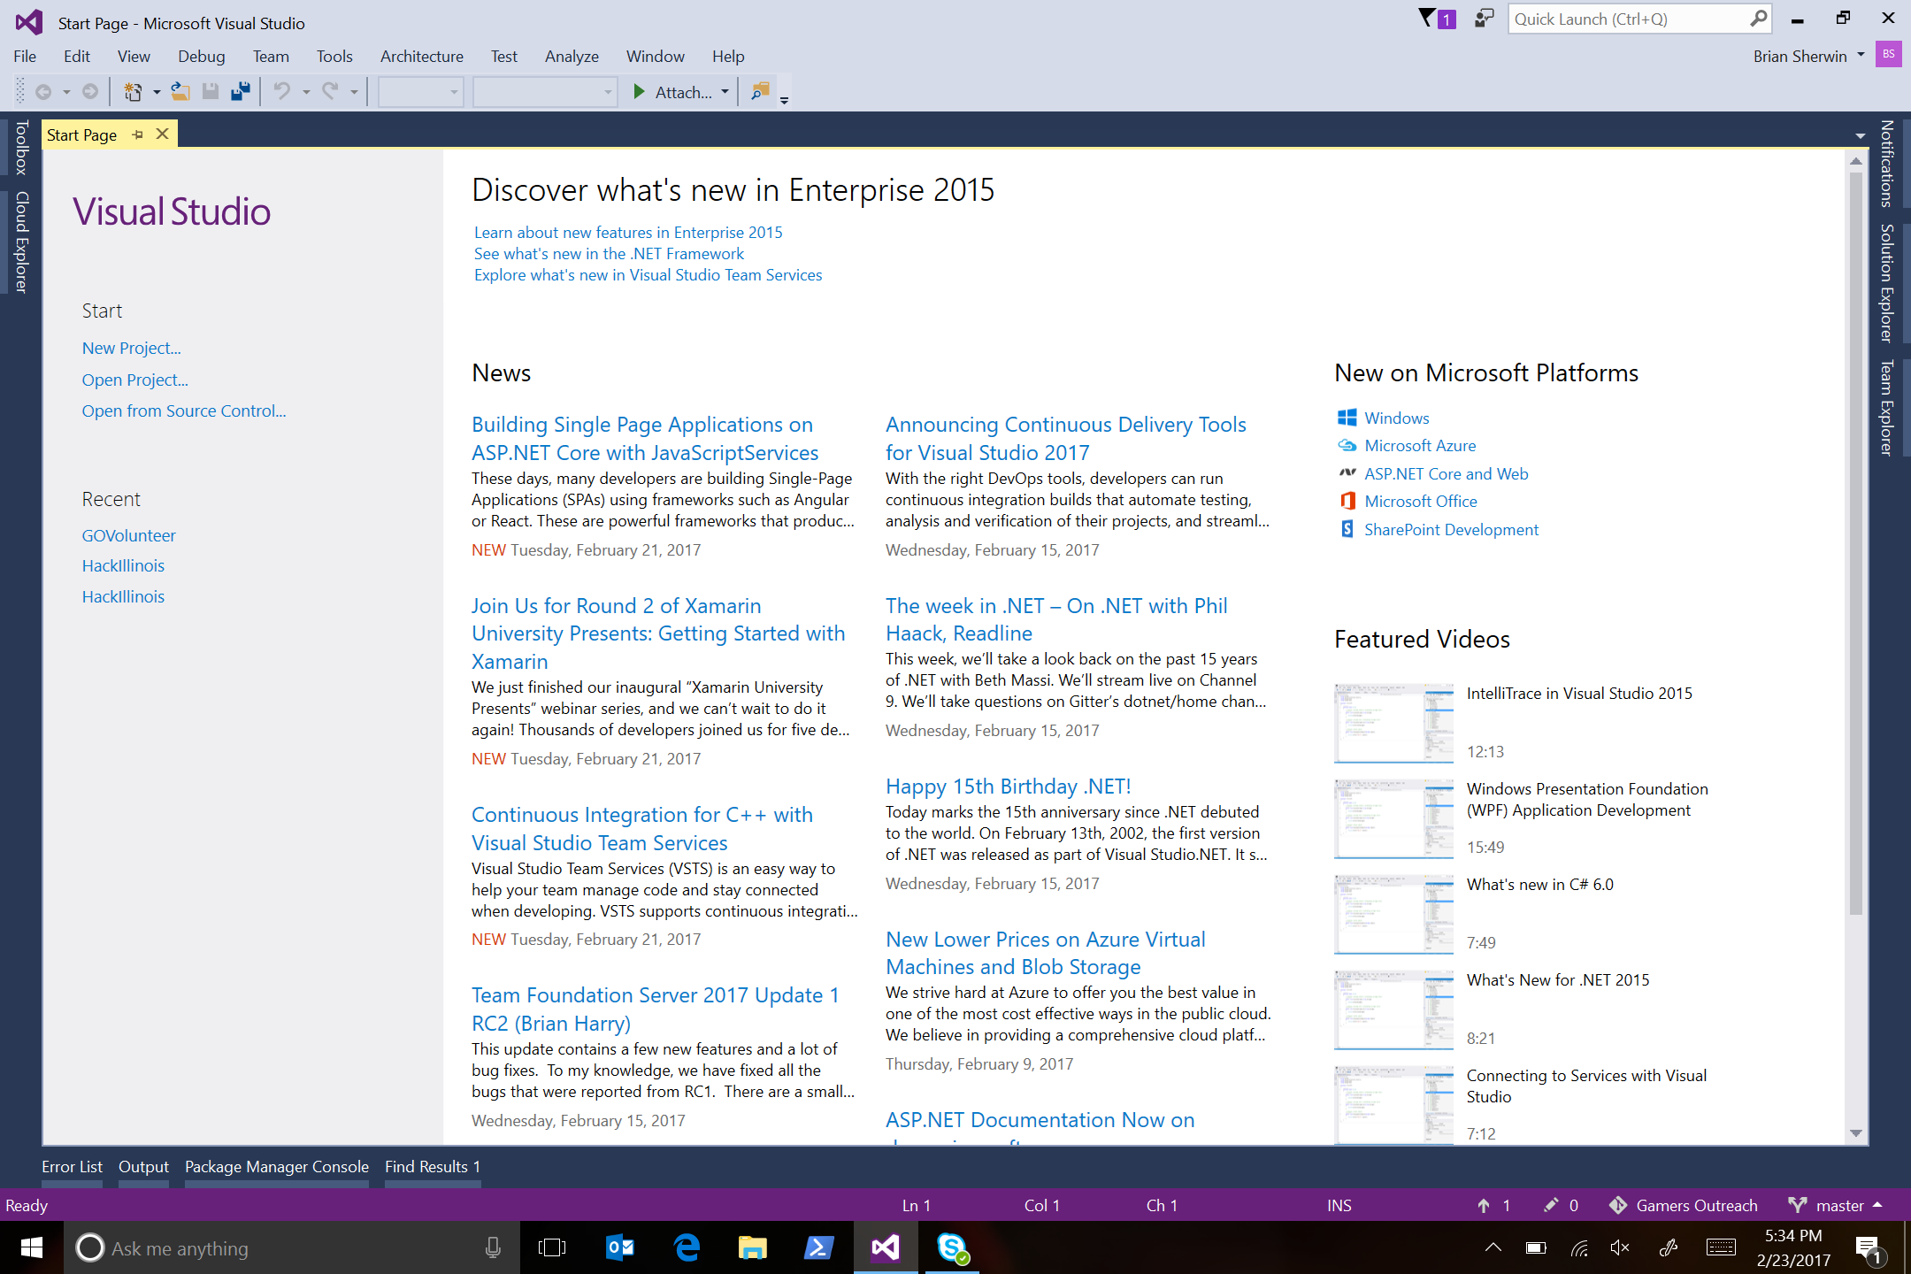

Slide 10
Start Page
Create a new project directly from the Start Page.
Quickly launch the new Clone from VSTS.
The Start Page MRU shows repos you've cloned on your other machines so you can easily clone them on your current machine.
Acquire remote repos from VSTS or use our more prominent MRU to open local projects and solutions easily.
Recently used templates will also roam across Visual Studio instances with a personalization account.

Slide 11
Improved Coding Experience
GoTo support
Coding help
.editorconfig
Extensions
Roaming
Open Folder (Node, Python)
…and…
Sign In

Slide 12
Improved Coding Experience

Slide 13
Language Support
Supports only Syntax Colorization and Autocomplete:
Bat, Clojure, CoffeeScript, CSS, Docker, F#, Groovy, INI, Jade, Javadoc, JSON, LESS, LUA, Make, Markdown ++, Objective-C, Perl, PowerShell, Python, Rust, ShaderLab, SQL, Visual Basic .NET, YAML.
Supports Code Snippets (in addition to Syntax Colorization and Autocomplete):
CMake, C++, C#, Go, Groovy, HTML, Java, Javadoc, JavaScript, Lua, Perl, PHP, R, Ruby, Shellscript, Swift, XML.
Supports Navigate To (in addition to Syntax Colorization and Autocomplete):
C++, C#, Go, Java, JavaScript, PHP, TypeScript, Visual Basic.

Slide 14
Live Unit Testing

Slide 15



Line of code covered by a failing test –
Line of code covered by a passing test –
Line of code not covered by any test -

Slide 16
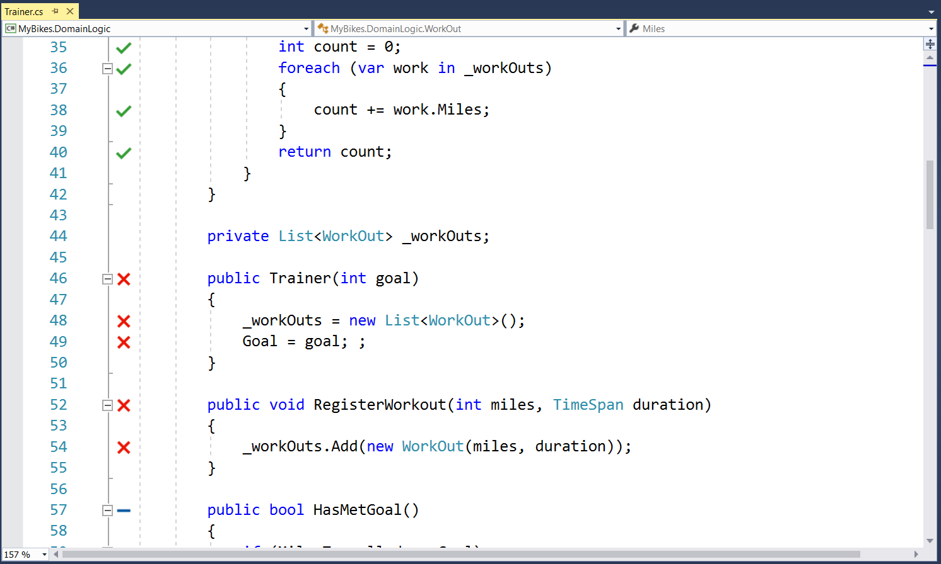

Slide 17
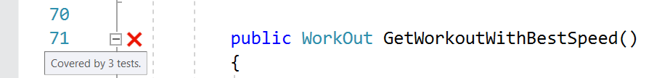
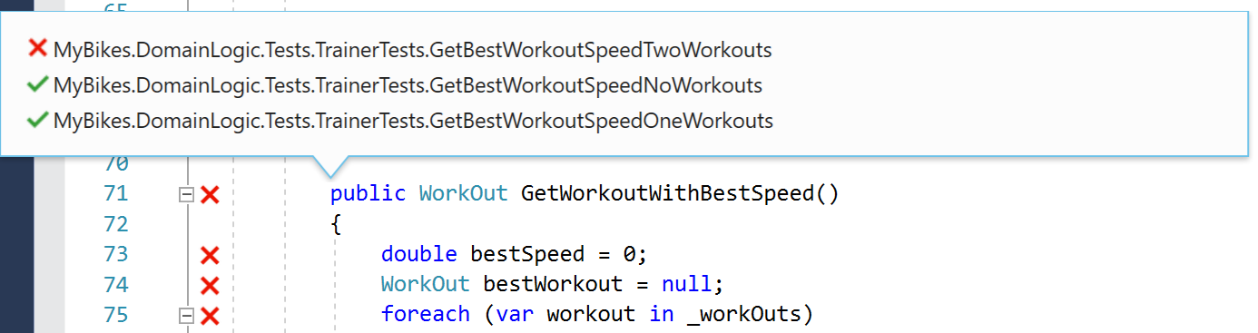

Slide 18
Debugging and Diagnostics
Overhaul of the Exception Helper and faster code navigation with Run to Click.
Plus, a new summary of your application events in the Diagnostic Tools window
Improvements to the CPU Tool.

Slide 19
.NET Core and Docker(Preview)
An early preview of the future .NET Core tooling is available as a workload under ".NET Core and Docker Tools (Preview)" in the new installer.

Slide 20
Team Explorer
The process for connecting to projects and cloning repos in VSTS has been personalized and streamlined.
You no longer need to connect to a project before cloning repos.

Slide 21
Other Languages
Visual C++
More than 250 bugs and reported issues have been fixed in the compiler and tools.
C# and Visual Basic
New refactorings to allow you to organize source code with one action.
F#
Support for F# 4.1 language features, improvements to the F# compiler and FSharp.Core, and a new editor based on Roslyn Workspaces.
Python
Many bug fixes and improvements, including more reliable Azure App Service and Cloud Service publishing.

Slide 22
Other Languages
R
Reliability and stability improvements.
Find R language support in the Data Science workload.
JavaScript and TypeScript
TypeScript 2.1 RC is available for all TypeScript projects in Visual Studio.
A new JavaScript language service is available and enabled by default.

Slide 23
Developer Command Prompt
Refactored scripts to support the new installation experience.
Can now run context specific commands
i.e. UWP vs. Classic Desktop
SDK Version (8.1, 10.0, etc)
Arch for binaries compiles (x86, amd64, arm)

Slide 24
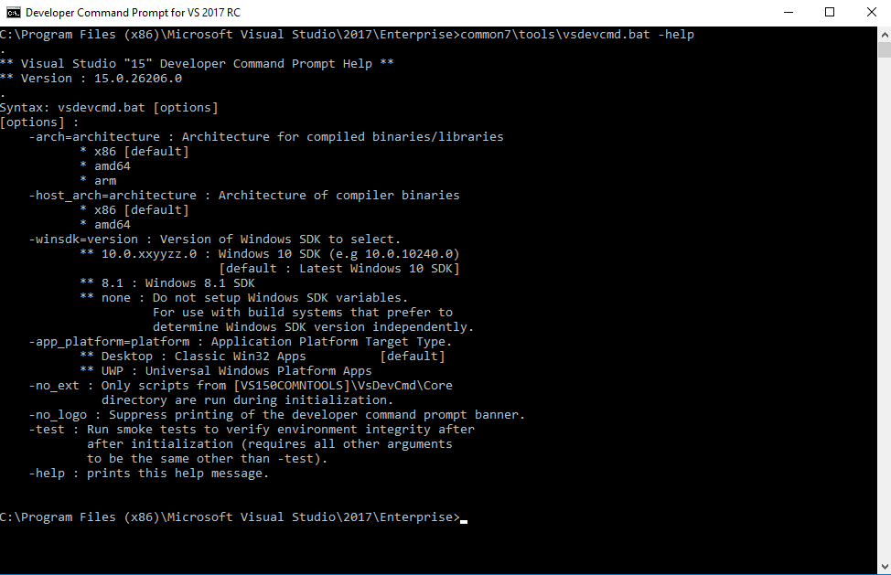

Slide 25
Tools for XAML Apps
XAML runtime toolbar – live focus tracking.
XAML Edit & Continue
XAML Editor improvements.

Slide 26
Tools for Universal Windows App Development
.NET Core NuGet framework
Cleaner XAML
Windows 10 Anniversary SDK and Phone Emulator
Preview support for the upcoming Windows 10 "Creators Update" SDK.

Slide 27
Other Product Support Tools
SQL Server Data Tools – SQL 2016
Office Developer Tools for Visual Studio
Visual Studio Software Development Kit
Breaking change with how Visual Studio consumes project and item templates in order to improve performance of template discovery.
Azure SDK for .NET
Node.js Tools for Visual Studio
Visual Studio Tools for Unity

Slide 28
Release is coming March 7…
Get ready.
Download from VisualStudio.com
Side by Side install
Remember breaking change with project templates…make backups before you test.
Provide feedback through Visual Studio…always available.
And…
Watch VisualStudio.com for March 7-8 Launch Event.

Slide 30
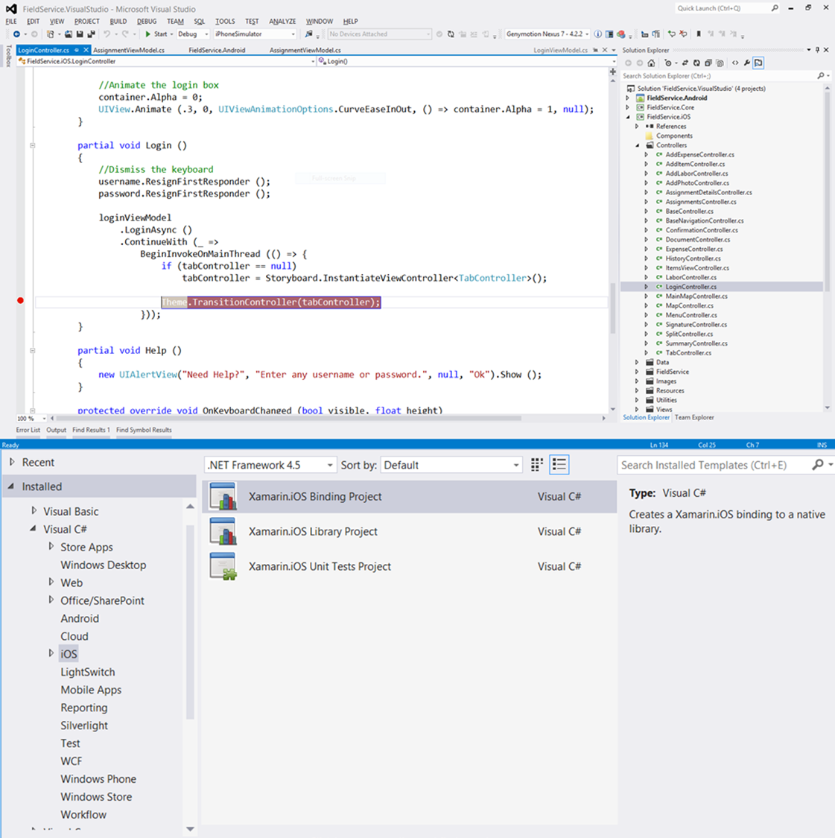
Xamarin and Visual Studio integration
A single solution for all projects
Build apps with beautiful UX and native performance for Android, iOS and Windows and be productive with templates, IntelliSense, cross-platform debugger, designer integration, emulators and deployment templates.
Leverage the Microsoft ecosystem
Integrate with Visual Studio Team Services
Use ReSharper or other tools for mobile projects
Use your favorite code coverage/profiling tools

Slide 31
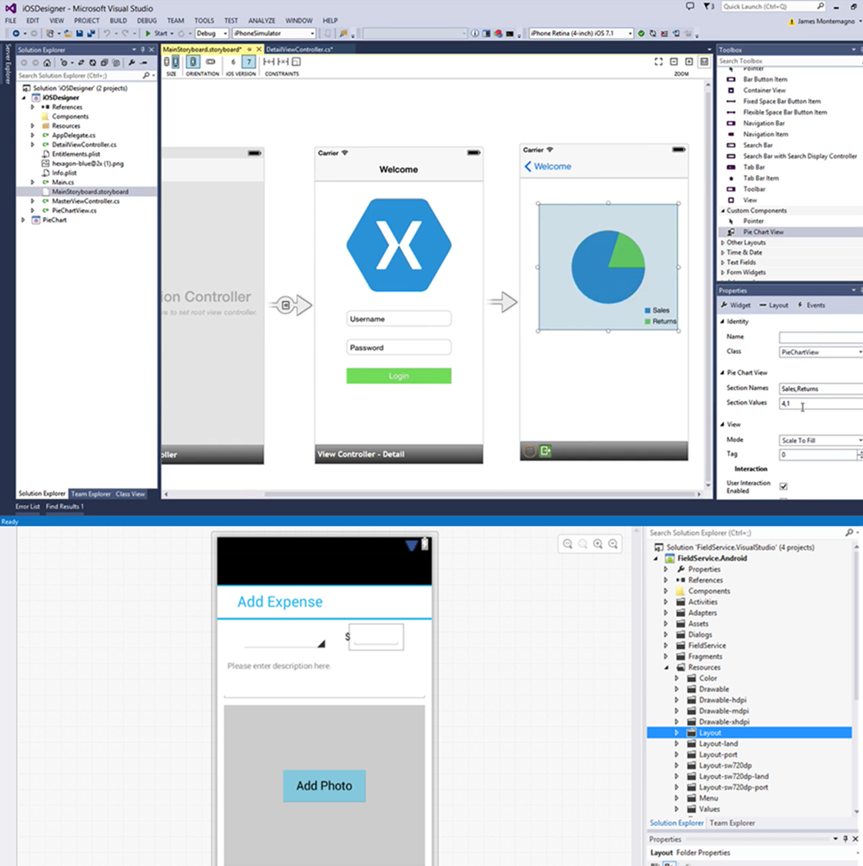
Native UI designer
Visual UI designers
Create native user interfaces for Android and iOS applications with drag and drop simplicity
Target multiple screen sizes, resolutions and OS versions with adaptive user interfaces
Layouts are saved in native resource formats
Experience the Xamarin Android and iOS designers in Visual Studio

Slide 32
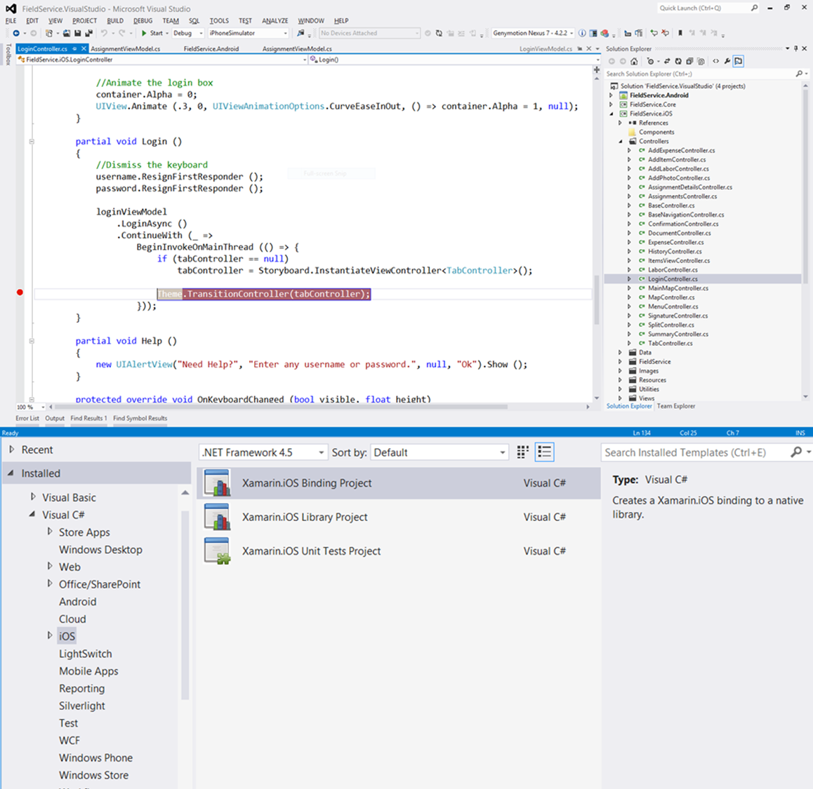
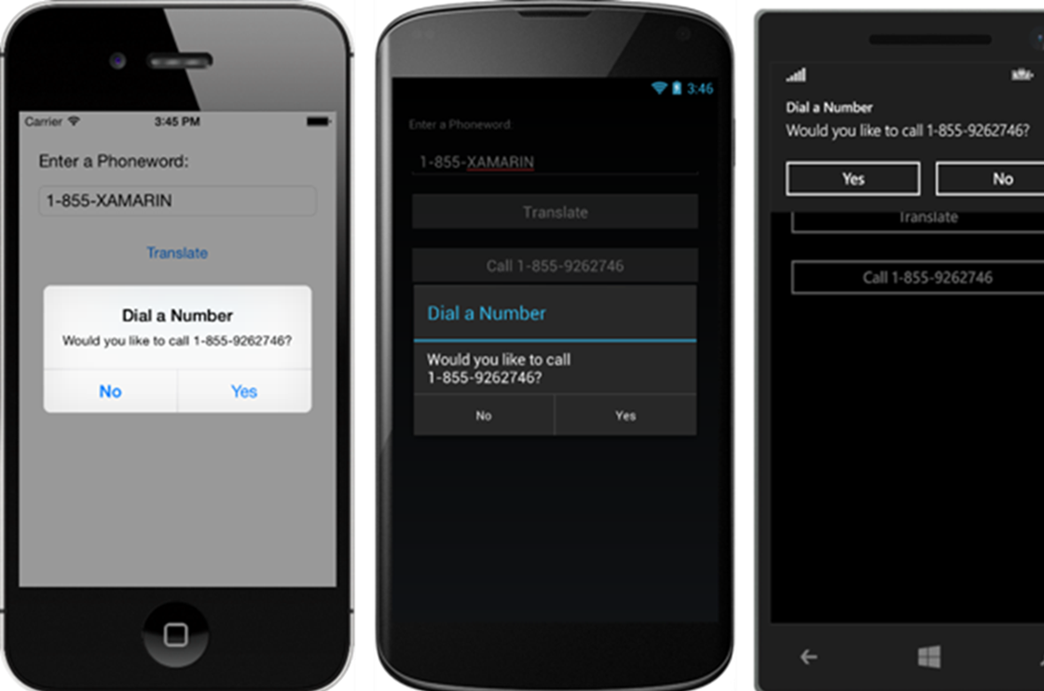
Xamarin.Forms
Great UX without the fuss
Build native user interfaces for iOS, Android and Windows from a single, shared C# codebase
If you know C#, you can build a mobile app with a great user experience for any platform
Over 40 controls and layouts are included to get you started quickly

Slide 33
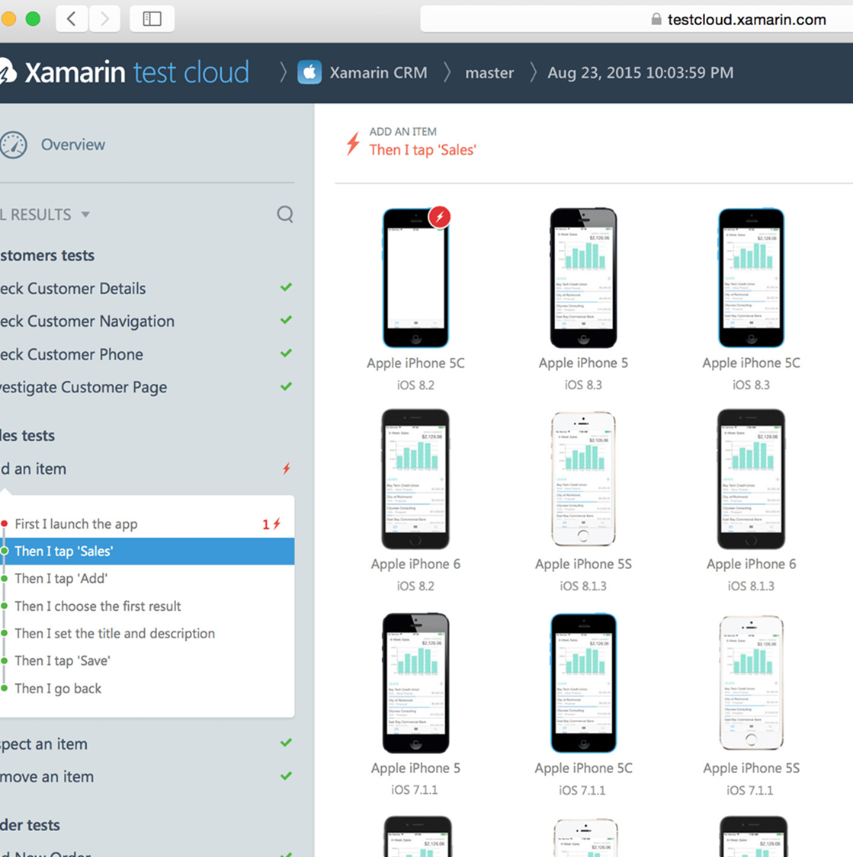
Xamarin Test Cloud
Thousands of devices
Automate your app testing and run it on over 2,000 different real devices/configurations. Test everything users do, and find any performance problems with step-by-step memory and performance tracking.
Real devices, real quality
Ensure higher quality by testing on real devices
Automate app testing on over 2,000 real devices
Use C#, Ruby, or Cucumber to build automated tests
Integrates with any continuous integration system

